Slide 2
All photos donated graciously by Dr. Gary W. Garrett at Apostolic Archives International.
For more info visit: www.apostolicarchives.com

Slide 3
LESSON ONE
the CASE for PENTECOST

Slide 4
Pentecost is named after a supernatural event recorded in the New Testament book of Acts. The literal meaning of Pentecost is fifty, and represents a Jewish feast held fifty days after the Passover.
Referred to as “The Feast of Harvest” or “The Feast of Weeks,” this celebration was a joyous time of giving thanks and presenting offerings to the Lord for the blessing of the wheat harvest.

Slide 5
The feast, first established in the Old Testament book of Exodus, had been passed down for generations. Known by Jews as Shavuot, Pentecost was one of the three pilgrimage feasts when all Jewish males were required to appear before the Lord in Jerusalem.

Slide 6
More than a feast passed down from ancient times, Pentecost marks the beginning of the New Testament church as it was baptized in the power of the Holy Ghost. What began in the upper room continues to this very day.
“For the promise is unto you, and to your children, and to all that are afar off, even as many as the Lord our God shall call” (Acts 2:39).

Slide 7
The book of Acts records the spread of Christianity throughout the Mediterranean world. It tells the story of the early church, as it was empowered by the Spirit of God. The book covers a period of over thirty years, and over the time Pentecost was experienced by people of many cultural and ethnic groups.

Slide 8
Pentecost is first and foremost an experience.

Slide 10
LESSON TWO
PARHAM and the OUTPOURING of PENTECOST at
TOPEKA

Slide 11
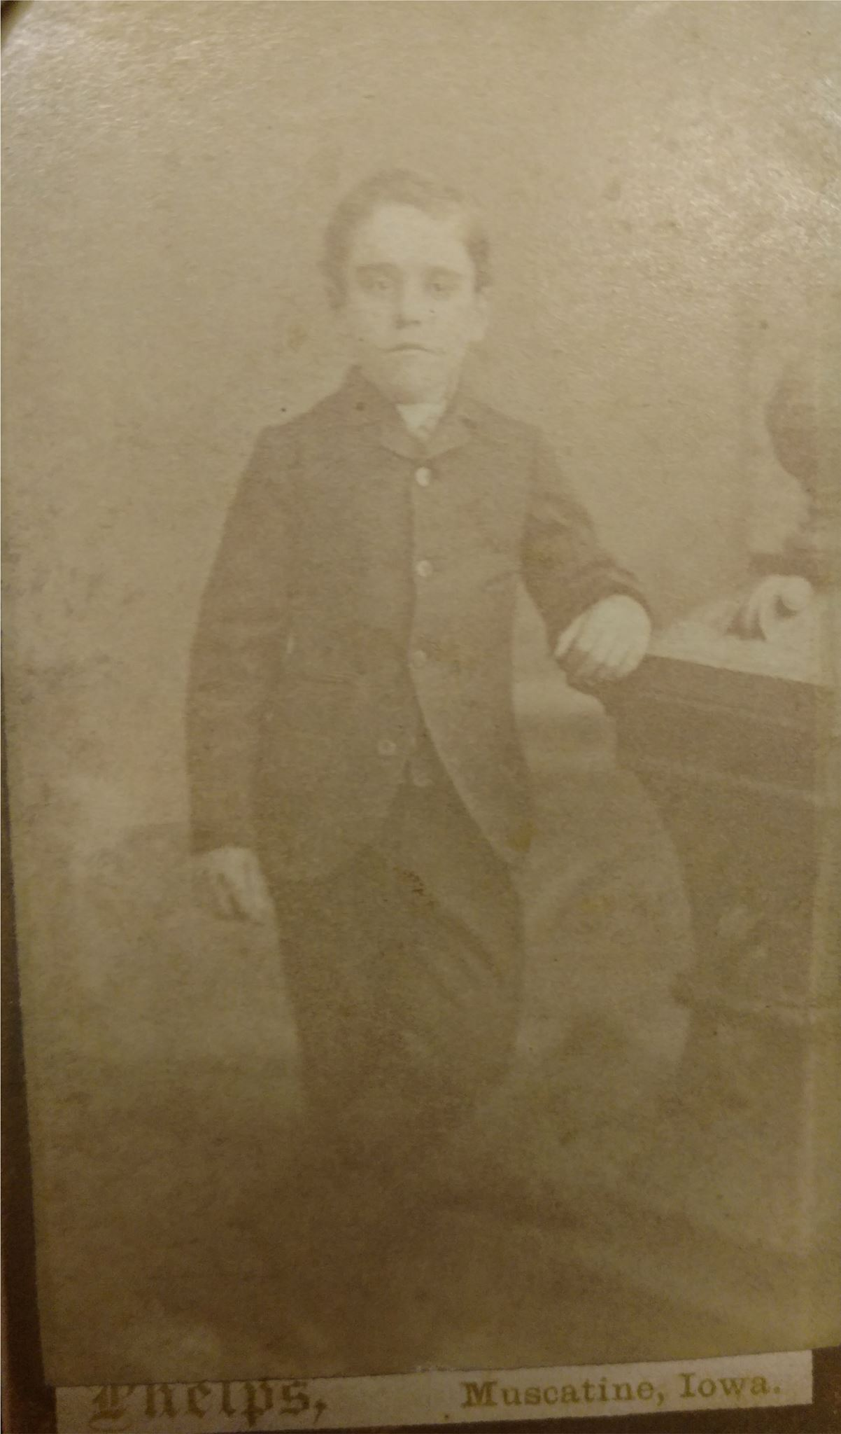
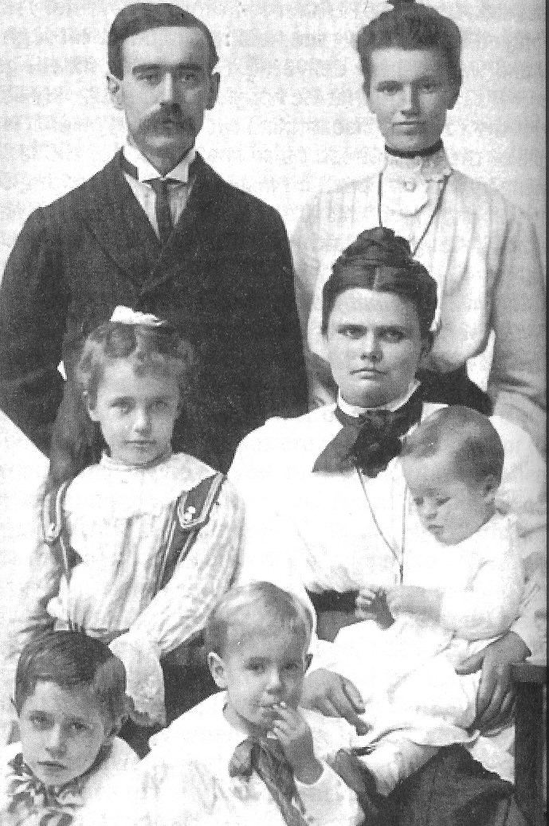
PARHAM FAMILY

Slide 12
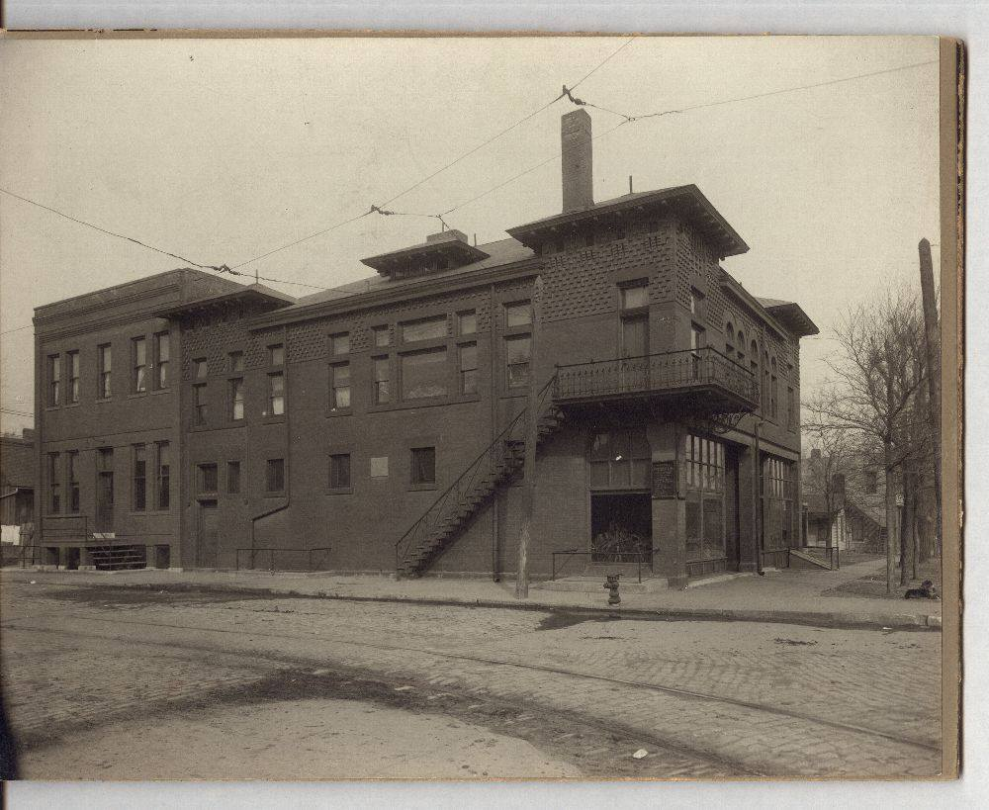
SITE FOR THE
BETHEL HEALING
HOME

Slide 13
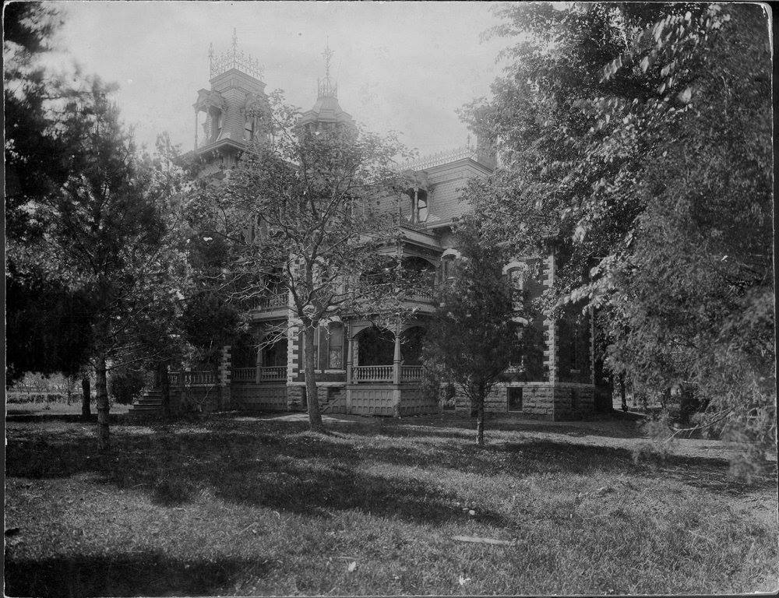
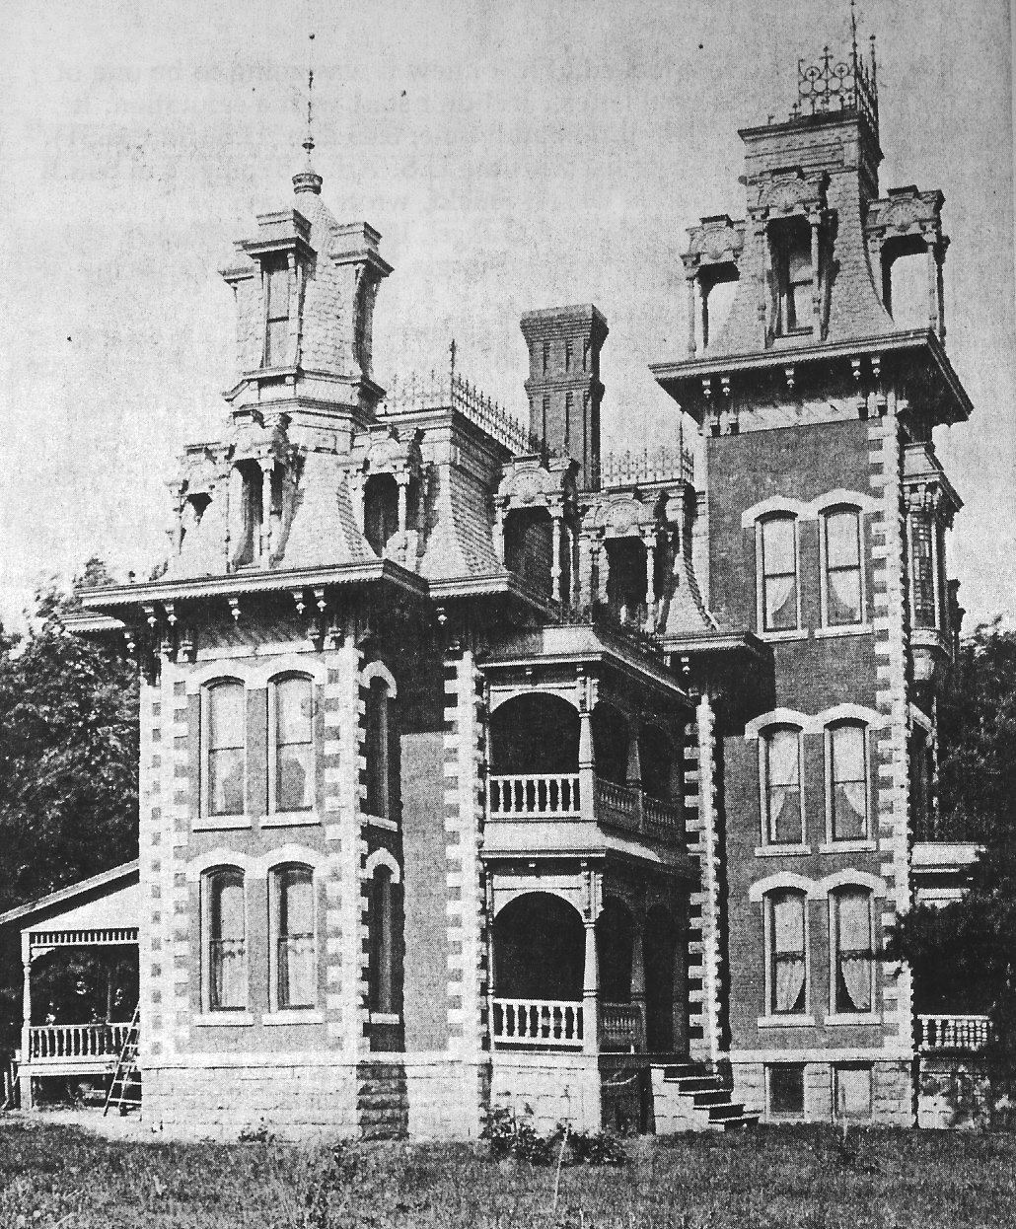
STONE’S FOLLY

Slide 14
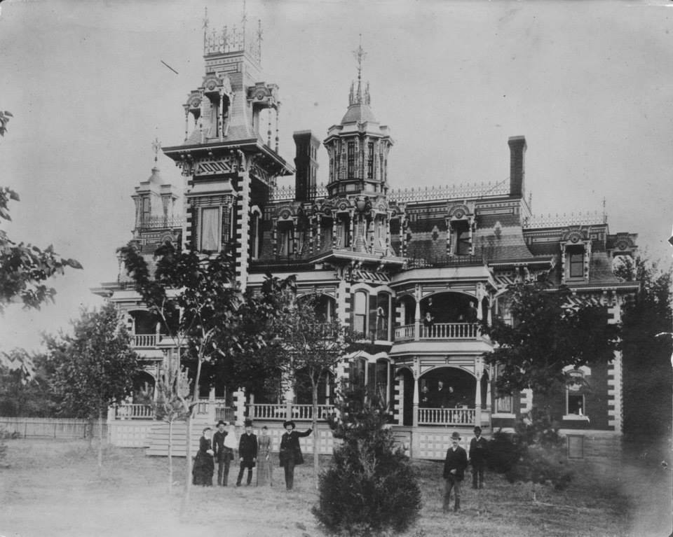

Slide 15
“I believed our experience should tally exactly with the Bible. Having heard so many different proofs as the evidence of their having the Pentecostal baptism, I set the students at work studying out diligently what was the Bible evidence of the baptism of the Holy Ghost, that we might go before the world with something that was indisputable because it tallied absolutely with the Word.”
-Charles F. Parham

Slide 16
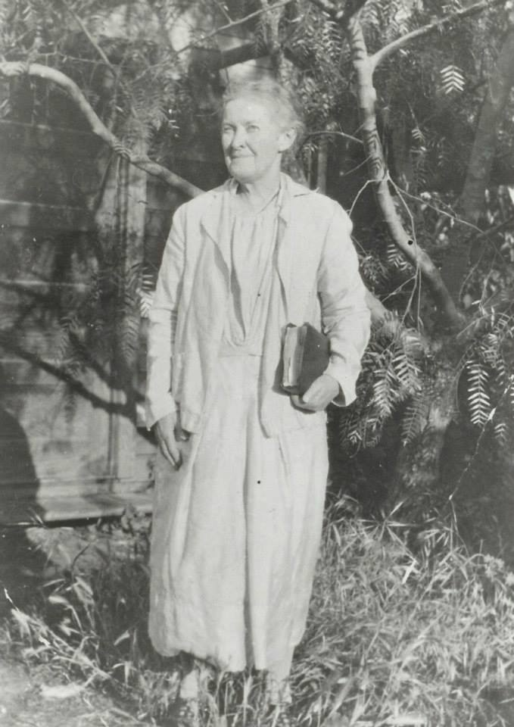
AGNUS OZMAN

Slide 17
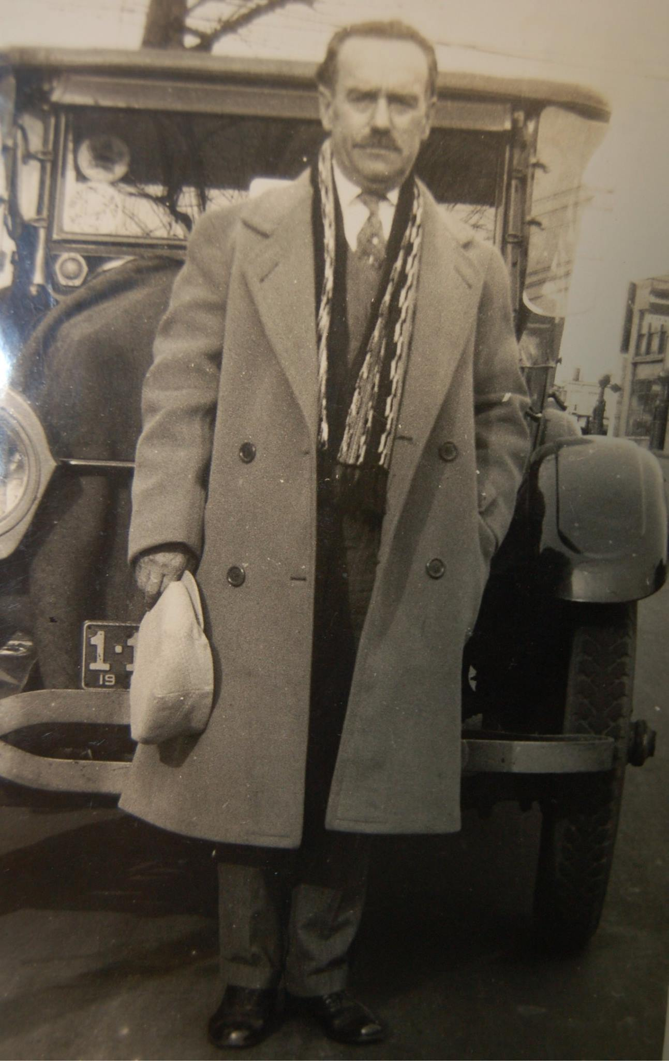
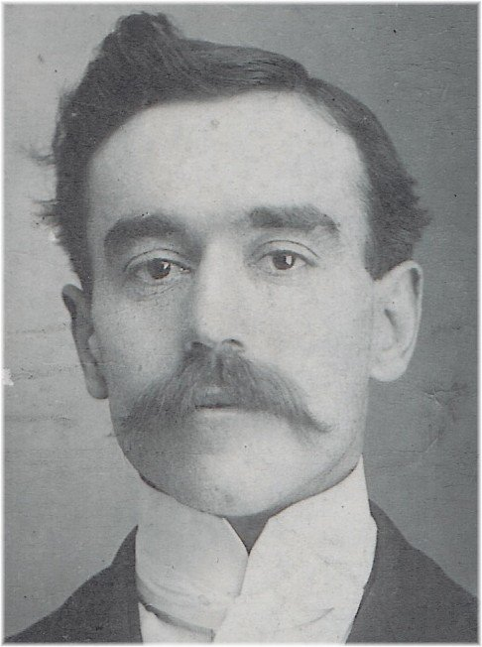

Slide 18
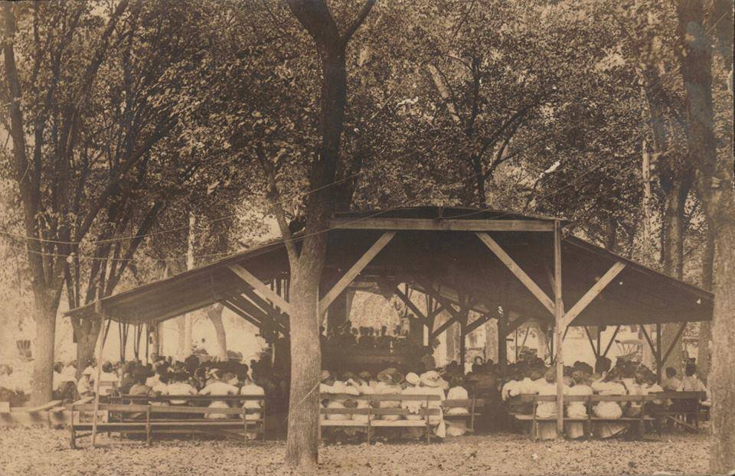

Slide 19
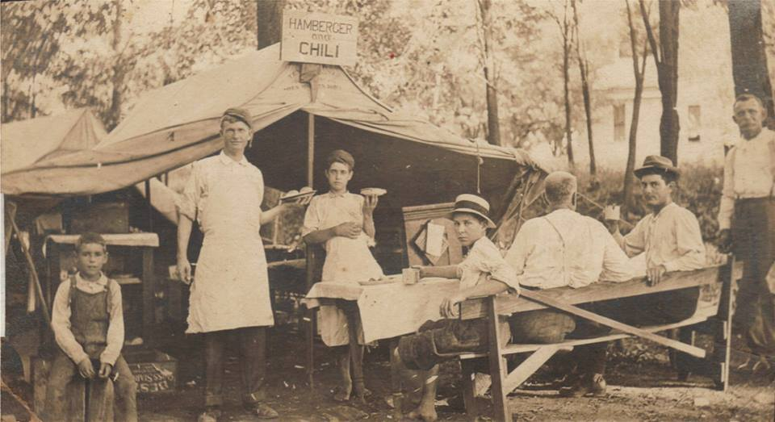

Slide 20
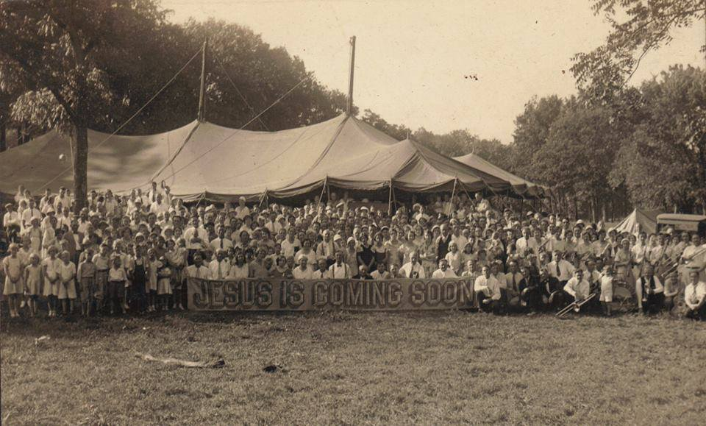

Slide 21
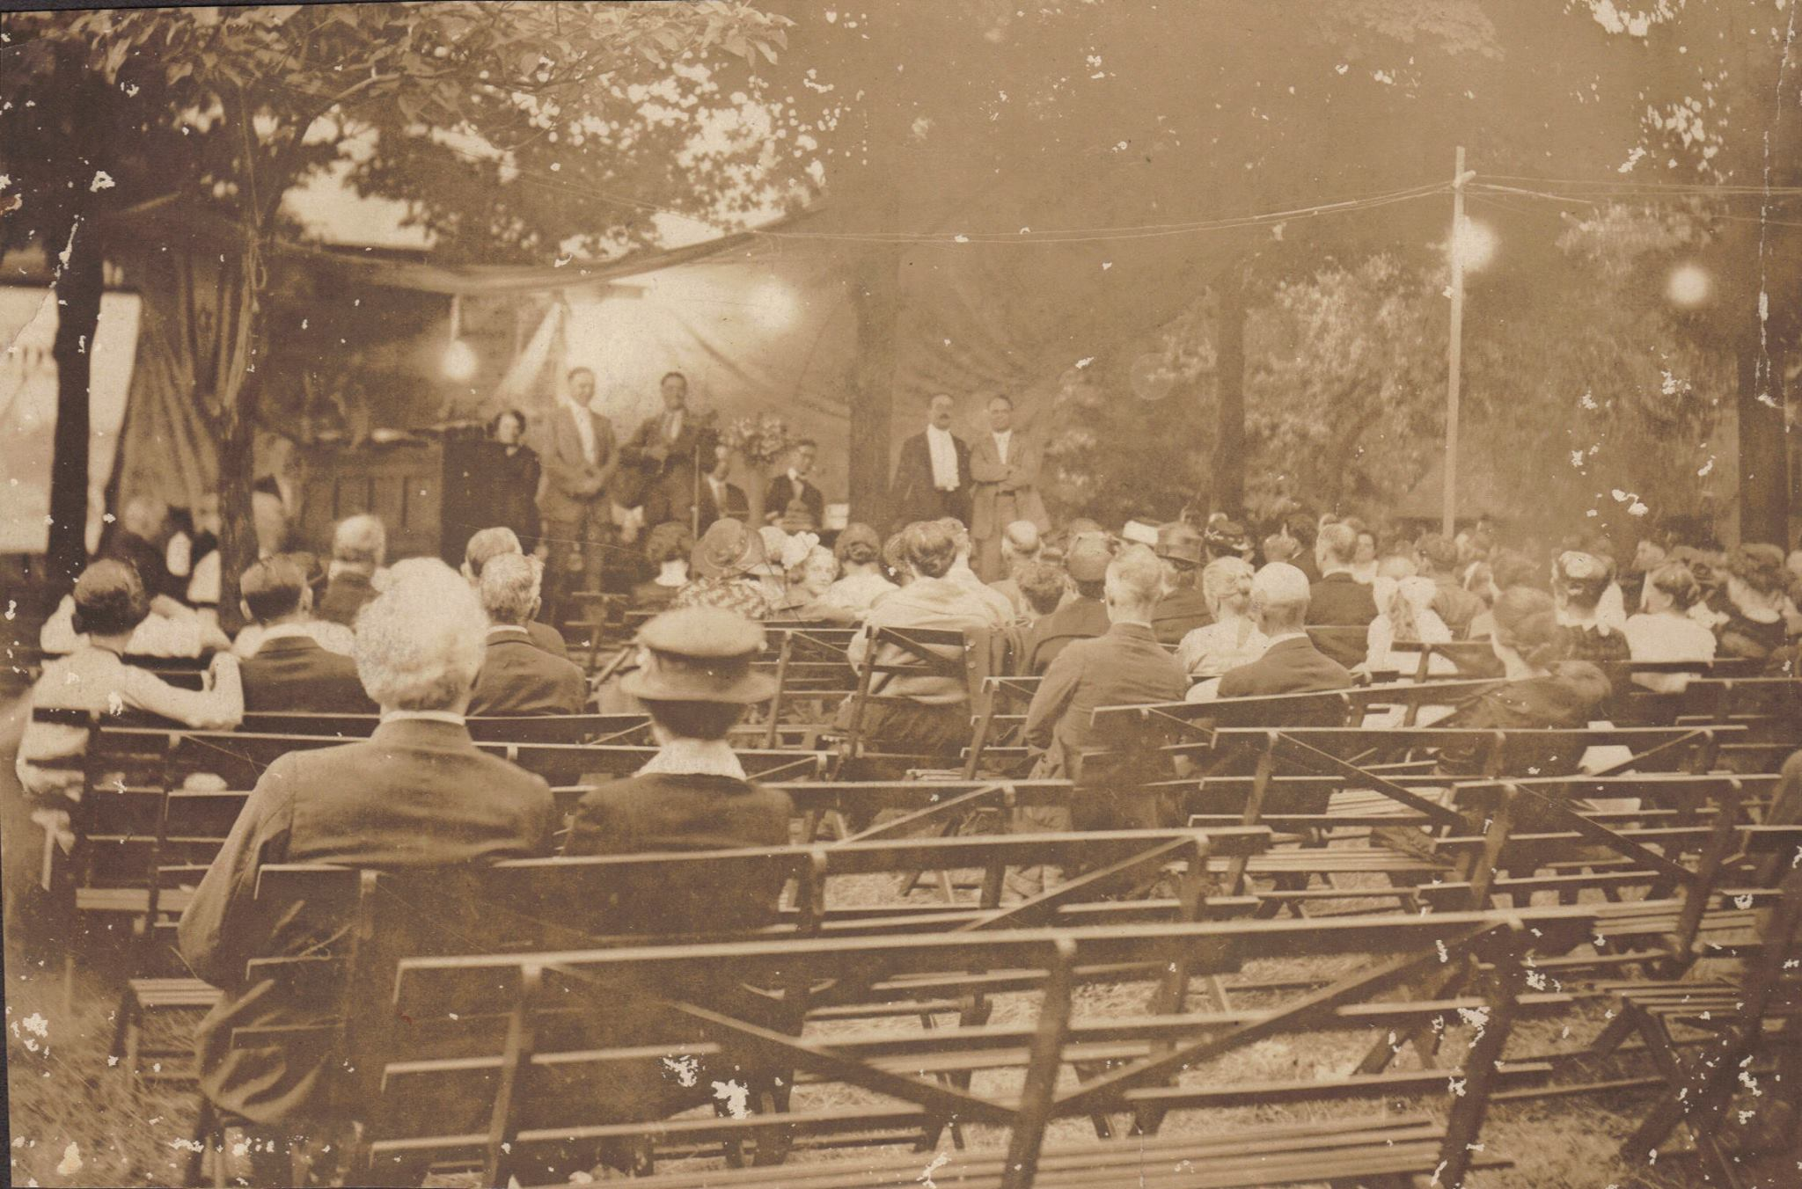

Slide 22
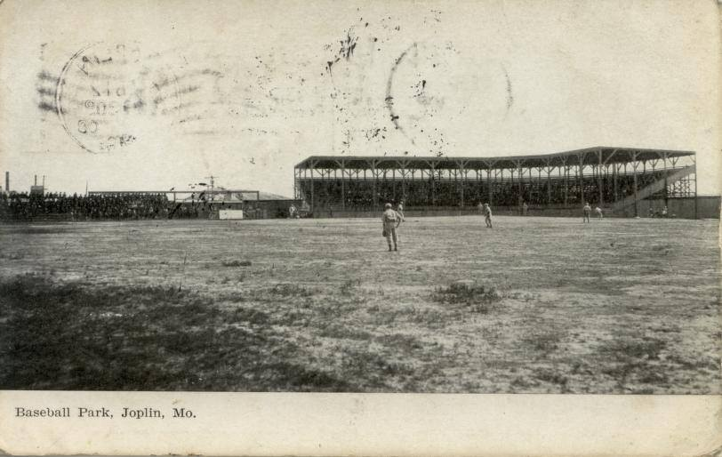

Slide 23
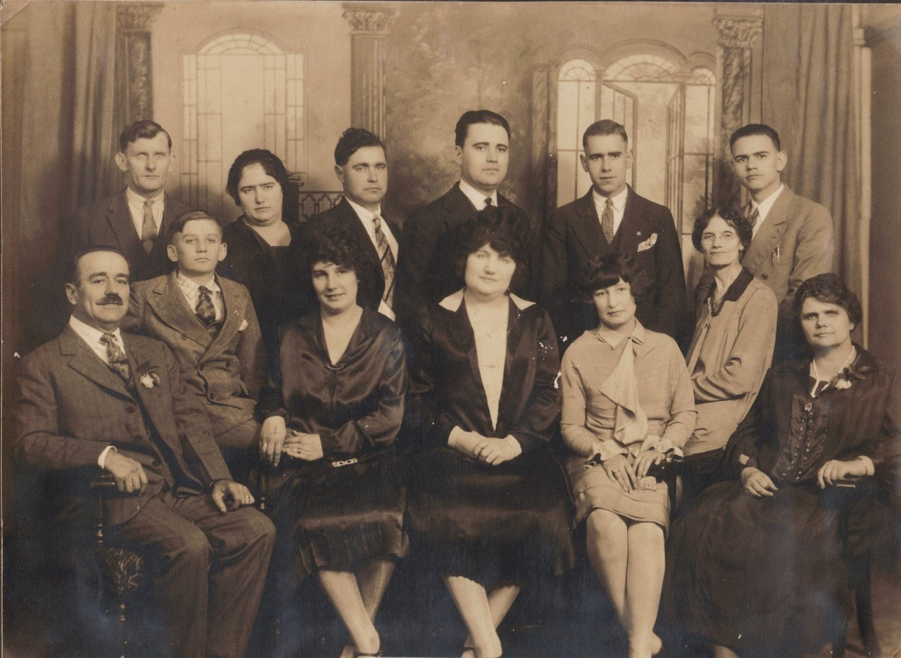

Slide 25
LESSON THREE
the FIRE spreads to AZUSA

Slide 26
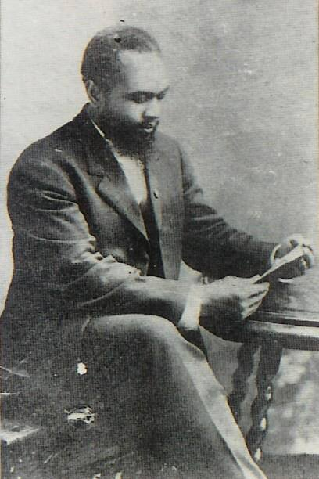
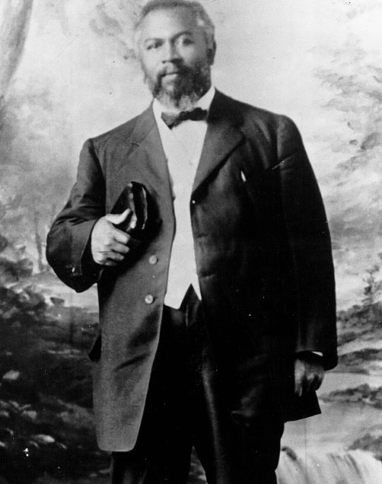
WILLIAM J. SEYMOUR

Slide 27
“We were given a thorough workout and a rigid training in prayer, fastings, consecration, Bible study and evangelistic work. Our week day schedule consisted of Bible study in the morning, shop and jail meetings at noon, house to house visitations in the afternoon, and a six o’clock street meeting followed by an evening evangelistic service at 7:30 or 8:00 o’clock.”
-One student’s description of Perham’s Bible School in Houston

Slide 28
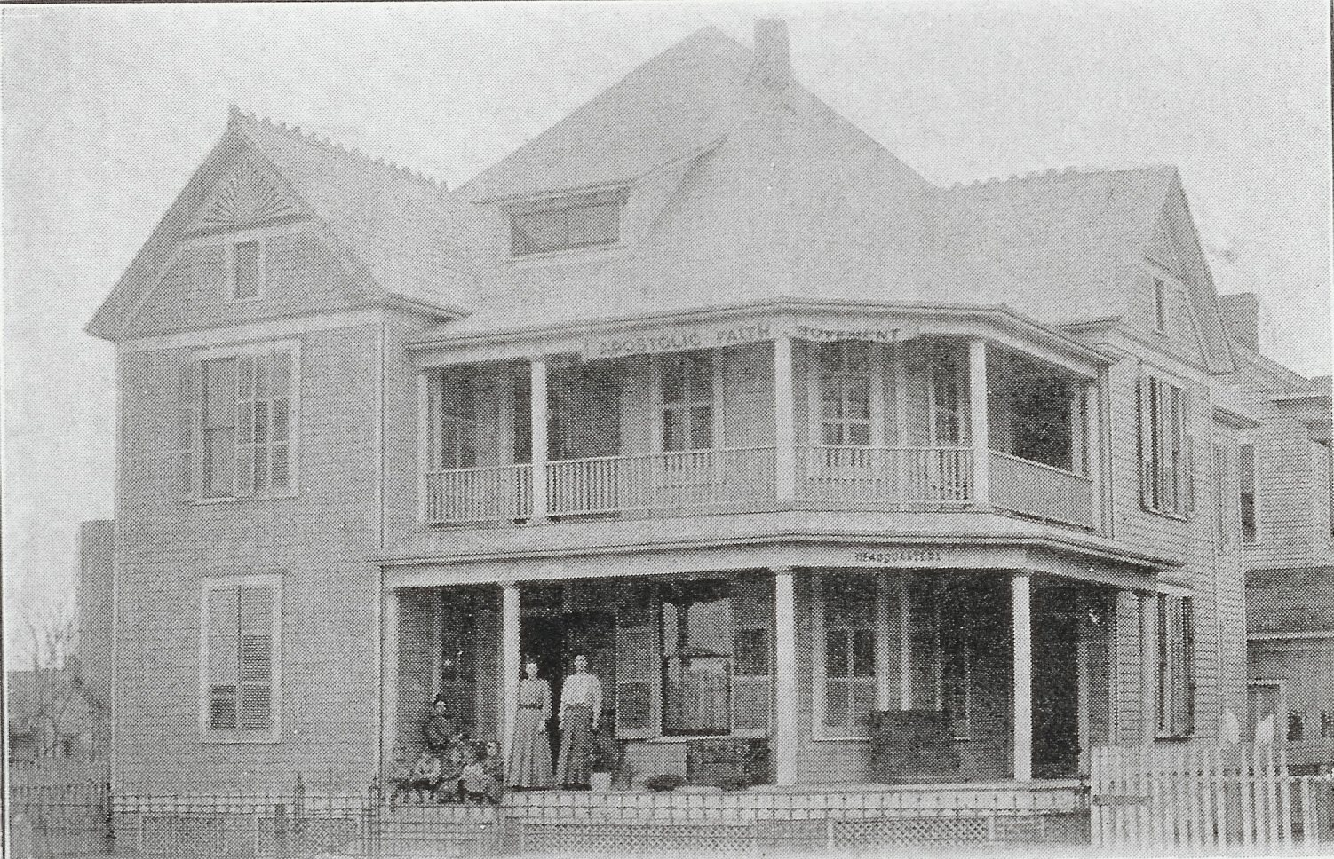
Site for the Bible school at 503 Rusk St. Sarah Parham and children pictured sitting on the porch

Slide 29
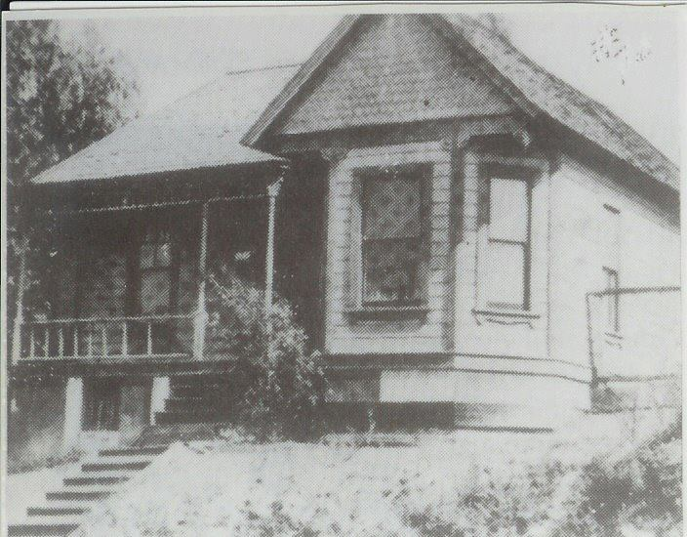
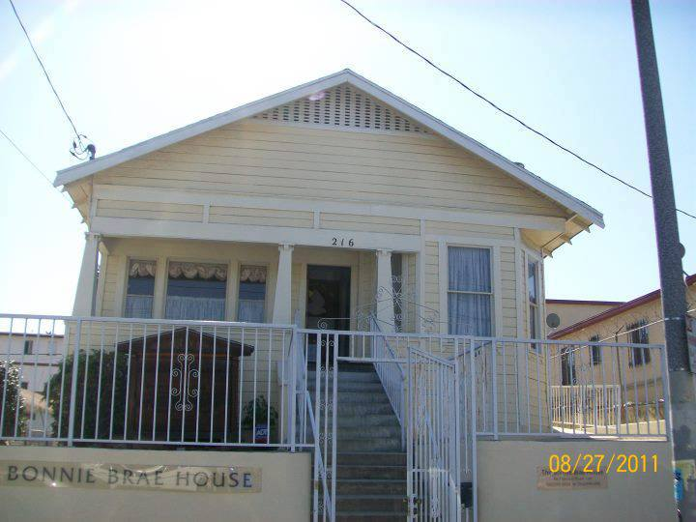
THE HOUSE ON BONNIE BRAE ST.

Slide 30
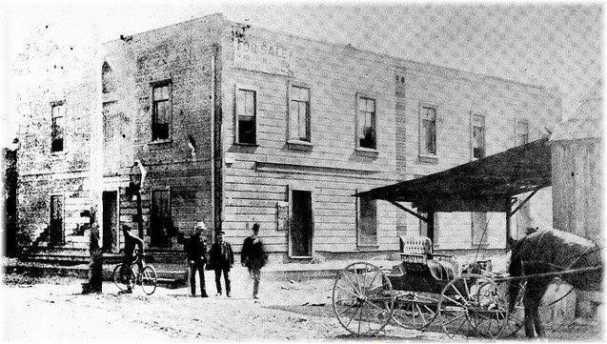

Slide 31
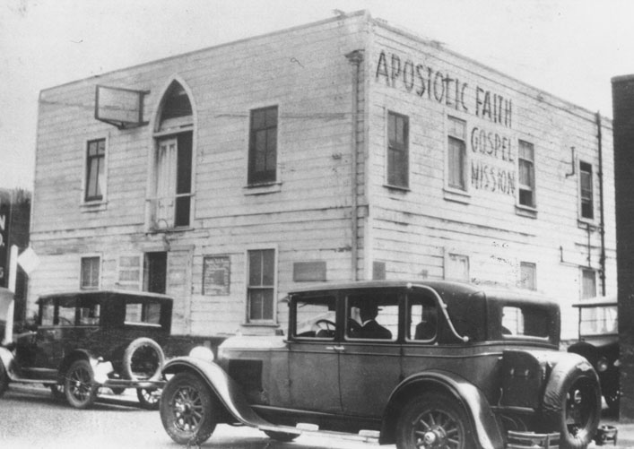
The Azusa Mission
in later years.

Slide 33
LESSON FOUR
from LOS ANGELES to the WORLD

Slide 34
“Only months after the mission was opened, it was reported that as many as 1300 attended the services; up to 800 crowded into the building and the rest standing on the boardwalk outside observing through the low windows and open doors. Every inch big enough for a chair was jammed full.”
–A.G. Osterberg

Slide 35
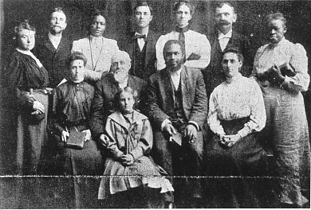
The Azusa Gospel Mission Credentialing Committee. These were the people who prayed (with the laying on of hands) for candidates who were receiving ministerial credentials.

Slide 36
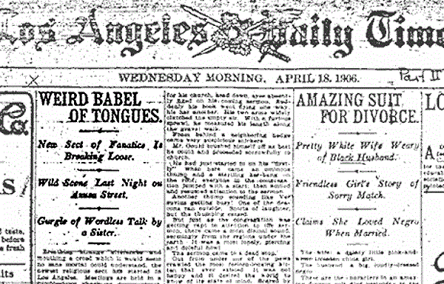
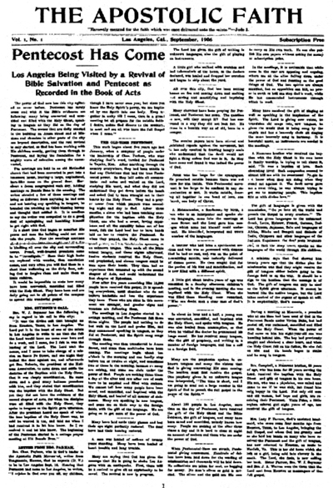
In a well-known article from the time, a reporter from the Los Angeles Times described the Azusa Revival in this manner:
“Weird Babel of Tongues – New Sect of Fanatics is Breaking Lose – Wild Scene Last Night on Azusa Street – Gurgle of Wordless Talk by a Sister.”

Slide 37
The most significant result of the Azusa Revival is the fact that it brought the global church back to an intensive study of the scriptures. With great emphasis on the Biblical example and model as portrayed in Acts, Azusa brought the world back to a first century experience baptized and empowered in Holy Ghost and in fire.
May the winds of memory, blowing off the history of the past, drive some of the consecration and dedication of those courageous people into the twenty-first century and beyond. – Fred Foster

